Slide 1
IBM University Engagement Project Submission
“Exploring the Power of Agentic AI with IBM Granite and IBM Bob”

Slide 2

Project Tile – [Smart Study Generator Agent]
Domain of Project – [Agentic AI and Intelligent Agents ]
Student Name | Recent Passport Photo | Email ID | Mobile number [WhatsApp]
Srinidhi S |  | srinidhishapur@gmail.com | 9740829044

Slide 3
Problem Statement -
Problem Statement : Smart Study Generator Agent
The Challenge
Students today face an overwhelming flood of information—lecture notes, textbooks, research papers, YouTube tutorials, and online resources. This content is scattered, unorganized, and often not personalized to their learning pace or style. As a result, students struggle with finding the right study material, summarizing key concepts, and staying exam-ready. Traditional study tools only provide static notes or flashcards, failing to adapt dynamically to student needs. The challenge is to move beyond static resources toward an intelligent, adaptive study companion.
The Objective
Build an agentic AI-powered Smart Study Generator that personalizes and streamlines learning for students. The solution should:
Fuse Learning Resources: Aggregate content from class notes, textbooks, research articles, and online tutorials into structured, easy-to-digest study material.
Enable Multimodal Input: Allow students to upload notes, voice queries, or images (e.g., textbook pages), and generate concise summaries, flashcards, or concept maps.
Create a Predictive & Agentic Layer: Recommend personalized study plans, highlight important topics based on syllabus or past exams, and provide predictive alerts (e.g., “Focus on Topic X—frequently asked in exams”).
Visualize Study Progress: Offer a real-time dashboard showing learning milestones, weak areas, practice quizzes, and performance forecasts.
Tech Stack (Mandatory)
IBM Langflow / IBM Orchestrate + IBM Models

Slide 4
Proposed Solution -
Solution – Smart Study Generator Agent
We propose an AI-powered Smart Study Generator Agent that helps students plan their studies, prepare learning materials, and get ready for examinations in an organized way. The system uses AI to create personalized study plans based on students' subjects, goals, available study time, and exam dates.
Personalized Study Plans: Generates daily and weekly study schedules, helping students manage their time and complete important topics before exams.
2. AI-Powered Notes Generation: Converts uploaded PDF and text materials into simple summaries, important points, and easy-to-understand notes.
3. Automatic Quiz Generation: Creates MCQs, practice questions, and flashcards from study materials to help students test their knowledge and improve understanding.
4. Progress Tracking: Tracks completed tasks and quiz scores through a dashboard, allowing students to monitor their preparation.
5. Smart Revision Recommendations: Identifies topics that need more attention based on student progress and quiz performance, helping students focus on weaker areas.
6. IBM AI Integration: Uses IBM AI services to support content summarization, study plan generation, and quiz creation.
Expected Outcome: The system saves study-planning time, improves time management, encourages regular revision, and provides students with a more personalized and effective learning experience.

Slide 5
Technology Used
IBM Bob platform -For designing and orchestrating multi-agent workflows visually
IBM Grainte model - for eg – ibm-granite-3-2-8b – For natural language understanding, reasoning, and personalization
IBM Cloud – It provides the infrastructure to build, deploy, and scale the Nutrition Agent efficiently. IBM Cloud enables a reliable, secure, and scalable environment for deploying the Nutrition Agent.
RAG– RAG to fetch real data first, then generate intelligent answers, making the Nutrition Agent more trustworthy and effective.
IBM Watsonx.ai - For model deployment, embeddings, and AI governance
Vector Database (FAISS/Chroma) – For RAG-based nutritional data retrieval

Slide 6
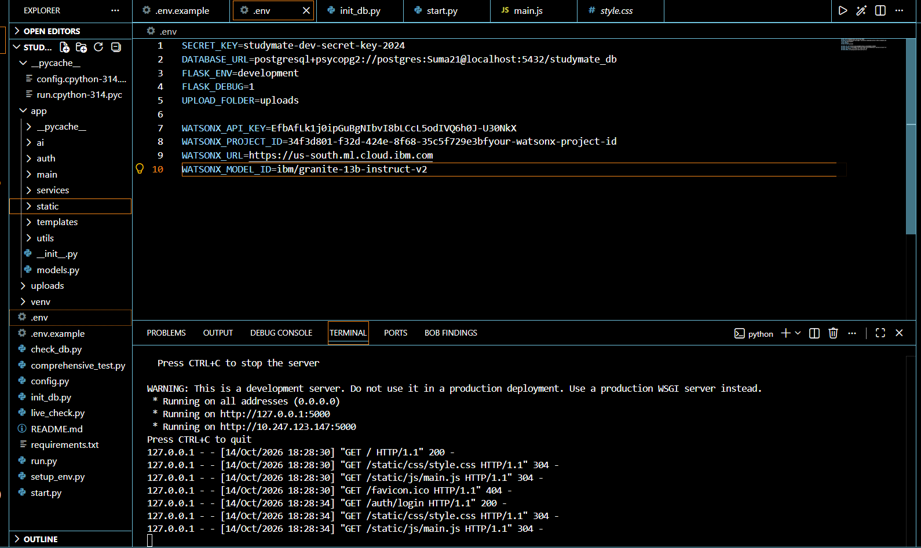
Required Files created using IBM bob -
App.py
Requirements.txt
Start.py
.env
Index.html
Style.css
Main.js

Slide 7
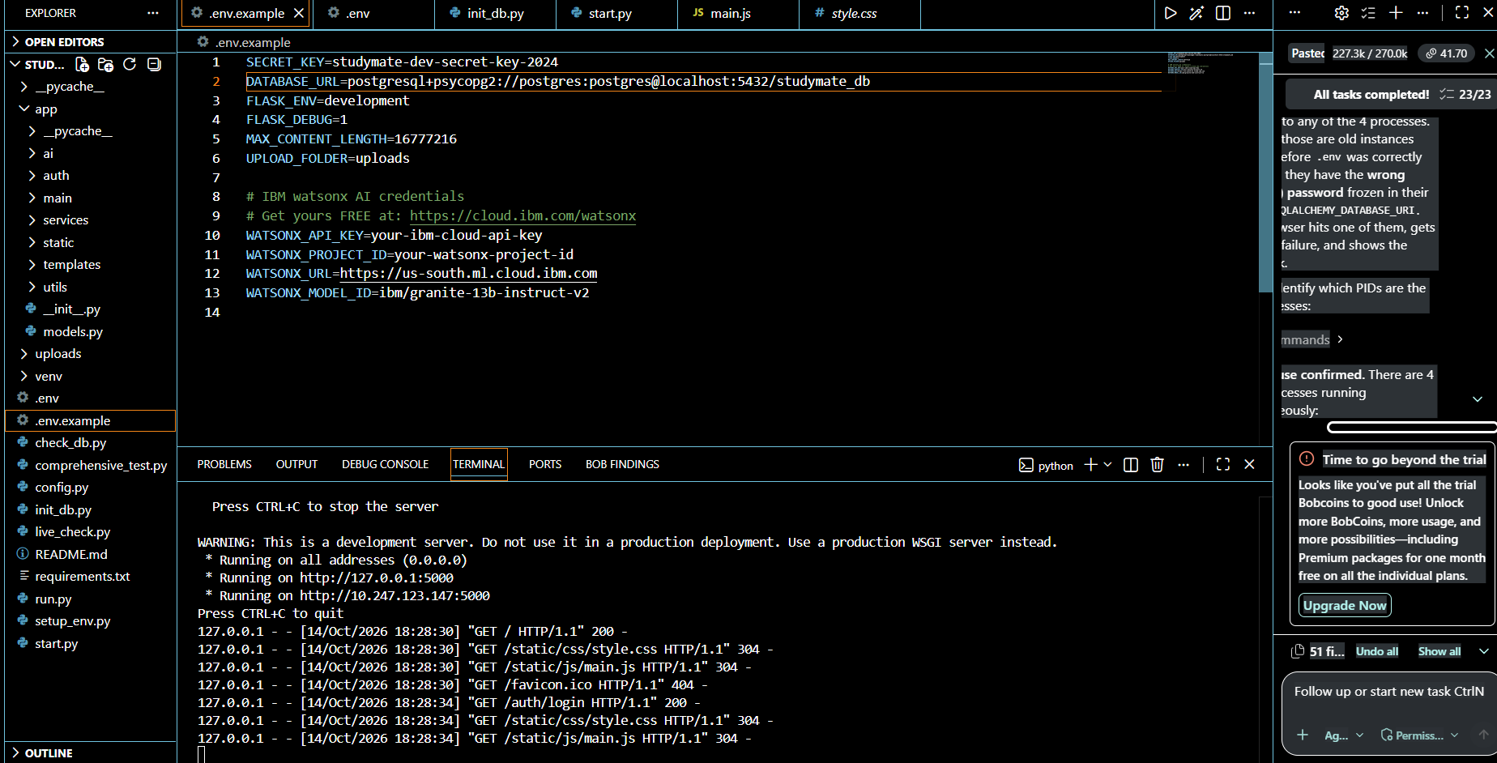
IBM Bob Screenshots:

Slide 8
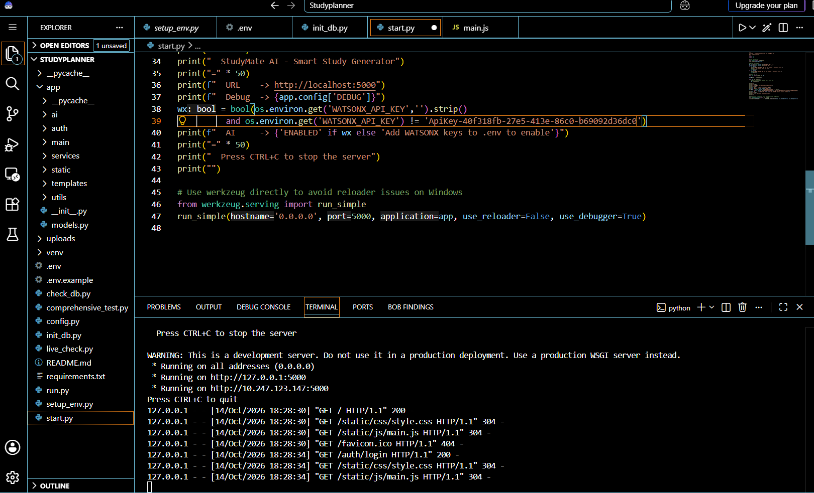

Slide 9
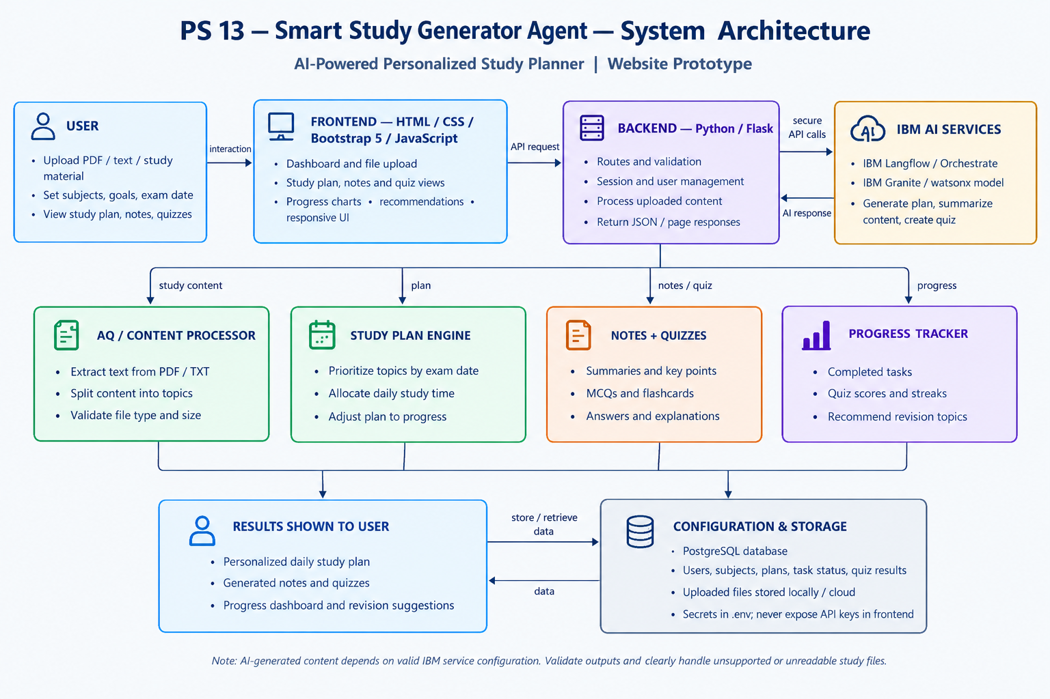
Architecture blueprint for IBM bob:

Slide 10

Role of Agentic AI in the solution
The Agentic AI in our Smart Study Generator Agent acts as an intelligent study assistant that plans, performs tasks, monitors progress, and adapts study recommendations according to the student's needs.
Intelligent Planning: Analyzes subjects, study goals, available time, and exam dates to create personalized study schedules.
Automated Content Generation: Generates simplified notes, summaries, quizzes, and flashcards from uploaded study materials.
Progress Monitoring: Tracks completed tasks and quiz performance to understand the student's learning progress.
Adaptive Decision-Making: Adjusts study priorities and recommends revision topics based on performance and pending tasks.
Personalized Assistance: Provides relevant study suggestions to help students focus on important topics and prepare effectively.
Key Role: Agentic AI makes the system more than a basic study planner by enabling it to plan, execute, monitor, and adapt learning activities with minimal manual effort from students.

Slide 11
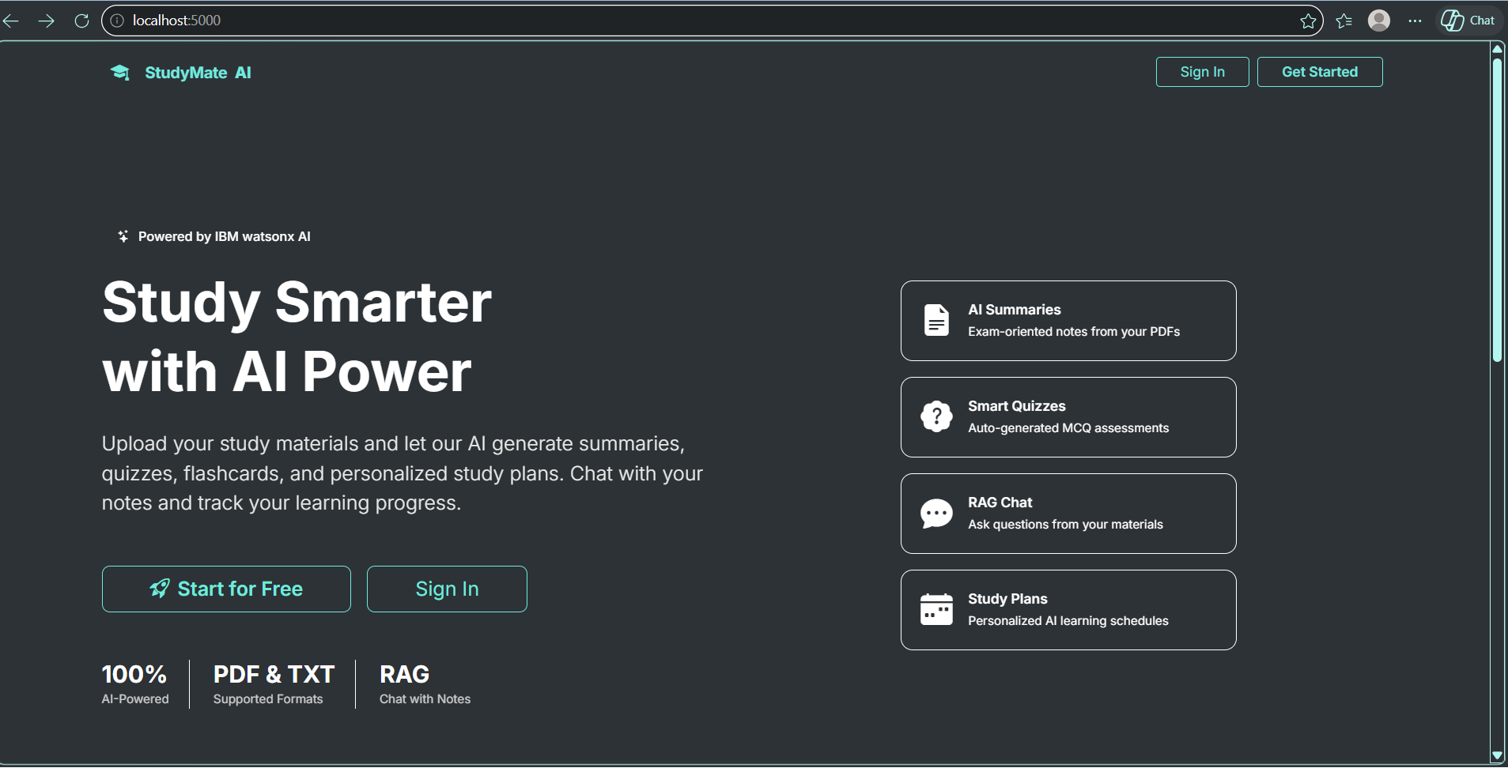
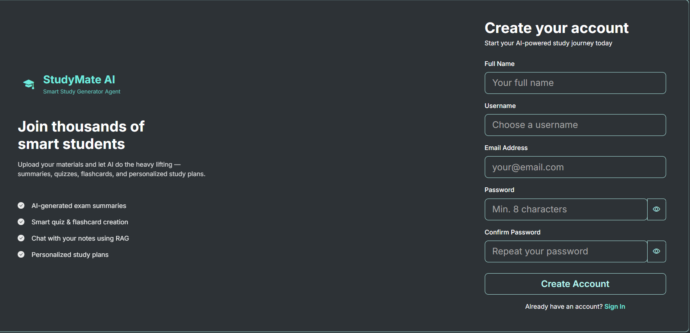
Project Output Screenshot
·
·

Slide 12
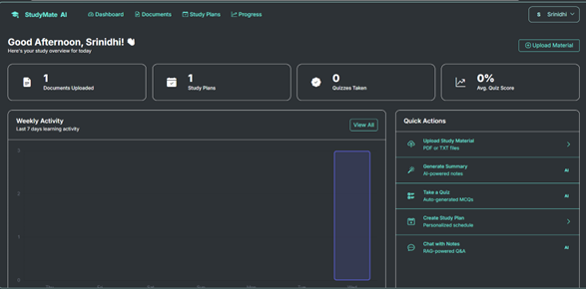
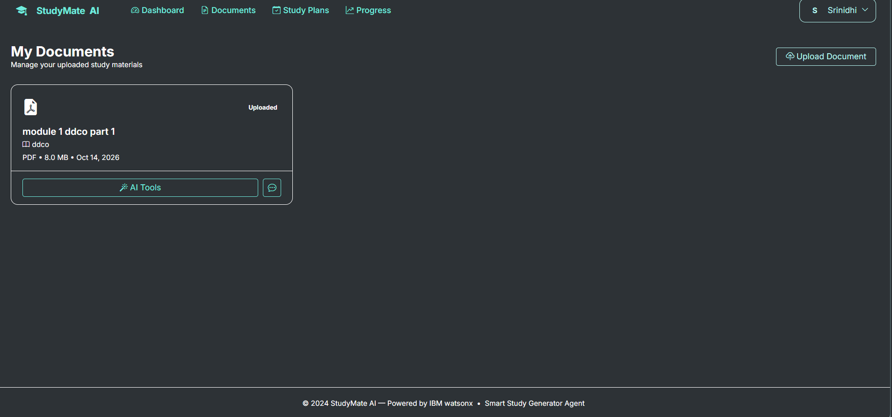
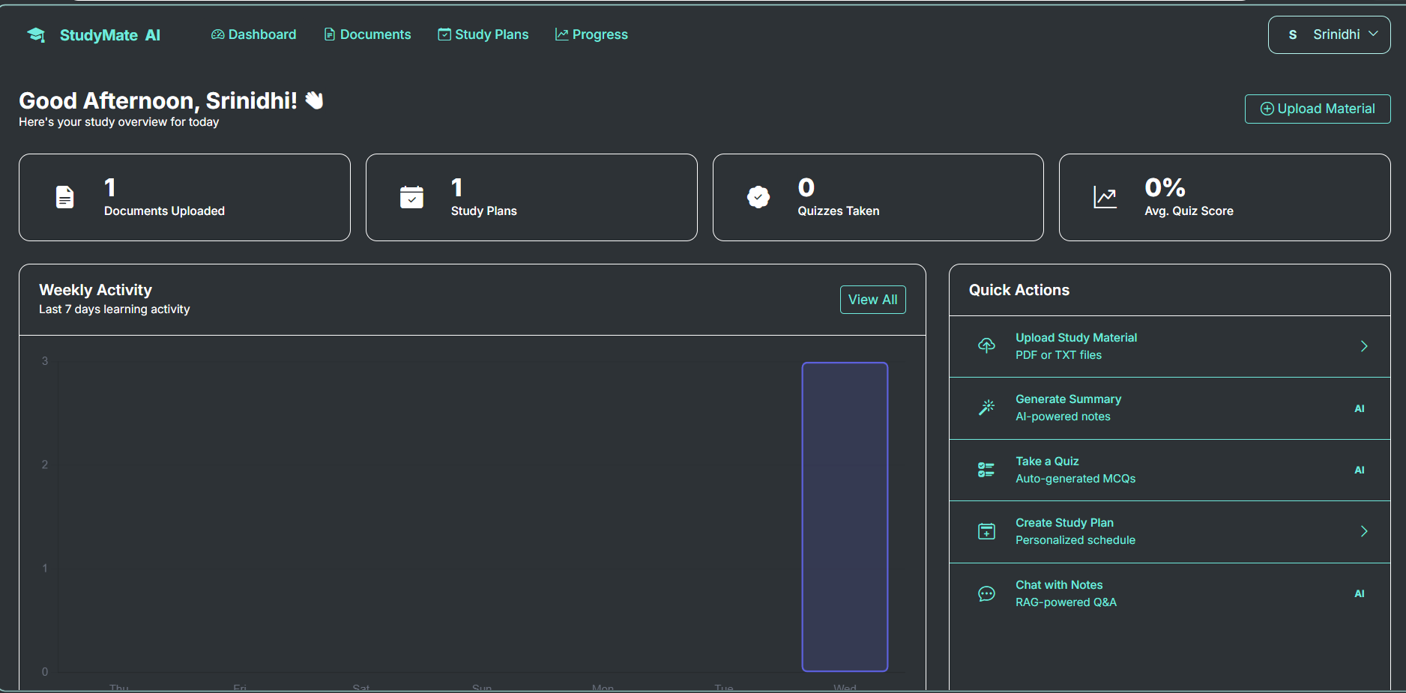
Project Output Screenshot
·

Slide 13
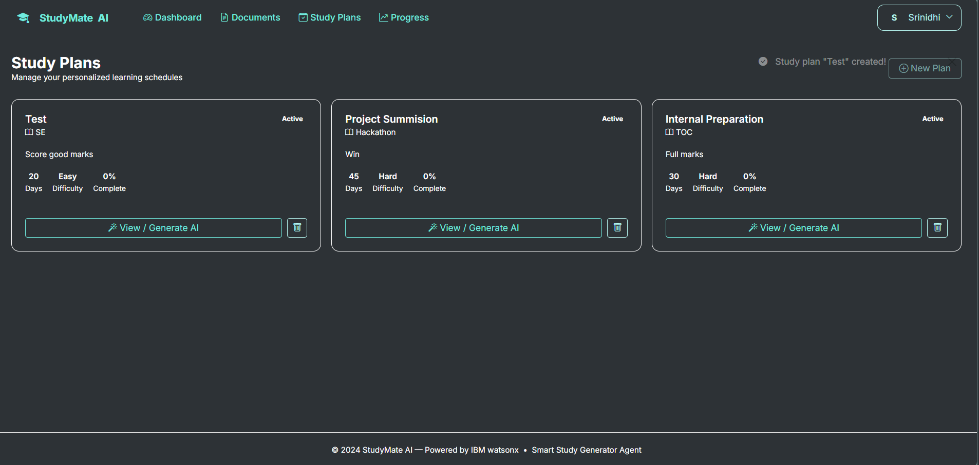
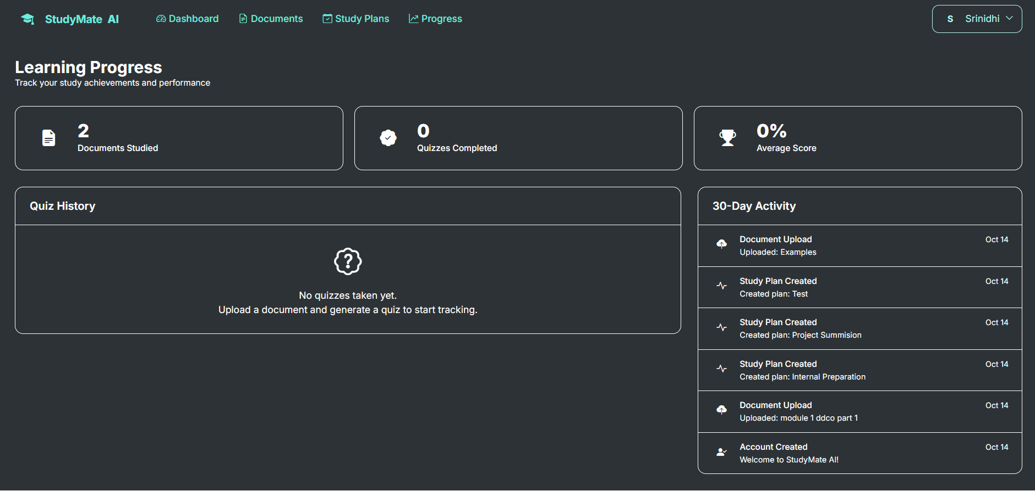
Project Output Screenshot

Slide 14
Novelty and Uniqueness
Our Smart Study Generator Agent stands out by combining personalized study planning, AI-generated learning materials, and adaptive progress monitoring in a single platform.
Personalized Learning: Creates study schedules based on individual goals, available time, subjects, and exam dates.
Automated Study Material Generation: Converts uploaded study materials into simplified notes, summaries, quizzes, and flashcards.
Adaptive Study Planning: Recommends changes to study priorities based on quiz performance, task completion, and pending topics.
Agentic AI Approach: Goes beyond a traditional planner by planning tasks, generating content, monitoring progress, and suggesting next steps.
Continuous Learning Support: Combines planning, practice, revision, and progress tracking in one application.
Reduced Manual Effort: Minimizes the time students spend organizing schedules and preparing revision materials.
Uniqueness: Unlike a basic timetable application, our solution integrates AI-powered content generation with progress-based study recommendations to provide a more personalized and adaptive learning experience.

Slide 15
Git Hub Link
Github URL –https://github.com/srinidhishapur/StudyMate-AI
(https://github.com/srinidhishapur/StudyMate-AI.git)

Slide 16
Future Scope
The Smart Study Generator Agent can be enhanced with advanced AI capabilities to provide a more personalized, interactive, and efficient learning experience for students.
Advanced Personalization: Develop smarter study plans that adapt automatically to students' learning speed, performance, and changing priorities.
AI Study Assistant: Introduce a conversational chatbot to answer questions and explain difficult concepts from study materials.
Voice-Based Interaction: Allow students to interact with the system using voice commands for easier and faster access.
Multilingual Support: Generate study materials in multiple languages to support students from different backgrounds.
Smart Reminders: Provide automatic notifications for pending tasks, upcoming exams, and scheduled revision sessions.
Performance Prediction: Analyze learning progress and quiz results to identify knowledge gaps and recommend areas for improvement.
Mobile Application: Extend the platform into a mobile app so students can access their study plans and materials anytime, anywhere.
Future Vision: To develop a complete AI-powered learning companion that continuously adapts to students' needs and helps them achieve their academic goals more effectively.

Slide 17
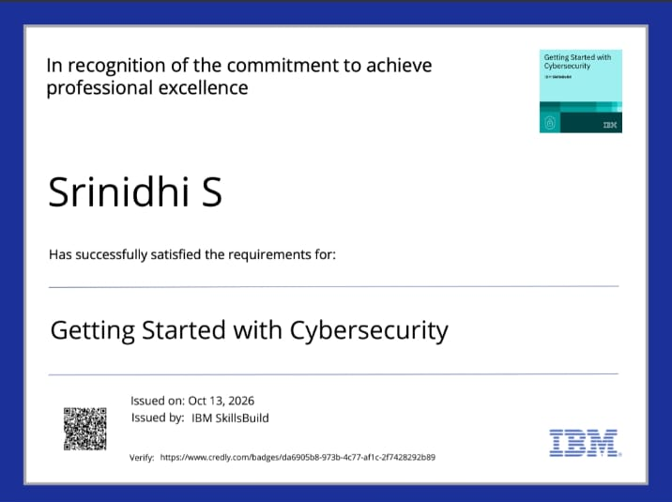
Certificates Earned:

Slide 18
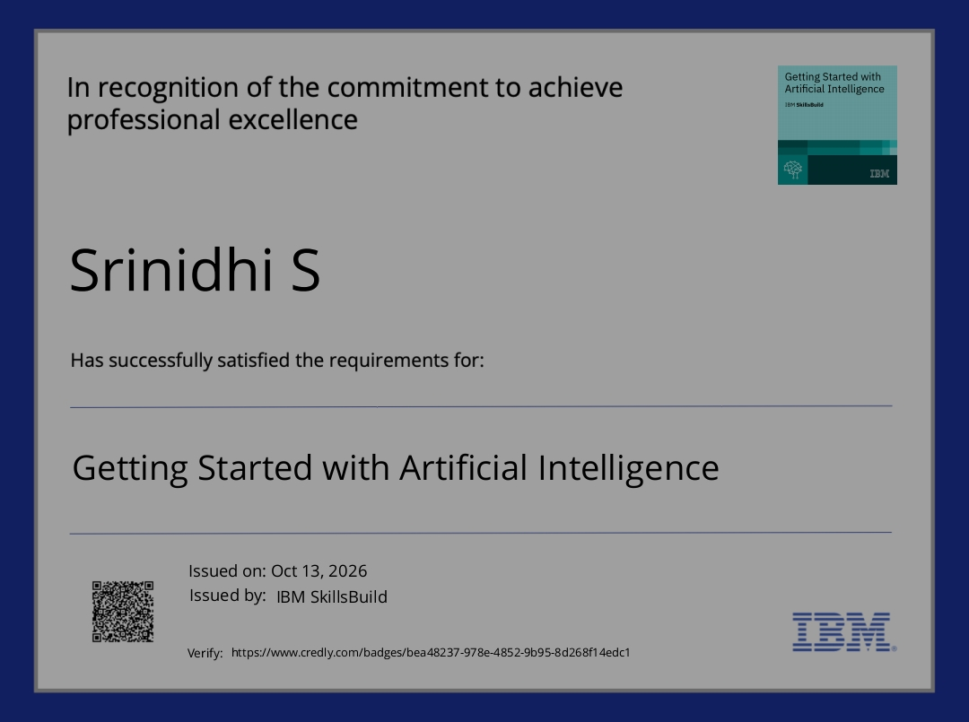
Certificates Earned:​

Slide 19


